Slide 1
ESSENTIALS FOR A SUCCESSFUL ADMINISTRATION OF CONSTRUCTION PROJECTS
: A CONTRACTOR’S QUANTITY SURVEYOR’S PERSPECTIVE
FRED BOLAJI JOHNSON
Notes:
Title Heading

Slide 2
A PAPER DELIVERED AT A ONE – DAY SEMINAR OF THE NIGERIAN INSTITUTE OF QUANTITY SURVEYORS, LAGOS STATE CHAPTER AT CMD, SHANGISHA MAGODO, LAGOS.
DECEMBER 2014

Slide 3
TABLE OF CONTENTS
INTRODUCTION 4
ESSENTIALS FOR SUCCESSFUL ADMINISTRATION OF CONSTRUCTION CONTRACTS 10
CONSTRUCTION PROJECT DURATION 19
CONSTRUCTION PROJECT COST 22
QUALITY PERFORMANCE 32
CLIENT’S ACCEPTANCE 36
HEALTH, SAFETY AND ENVIRONMENTAL (HSE) PRACTICE 41
THE CONTRACTOR’S PERSPECTIVE 44
CHALLENGES AND CONCLUSION 51

Slide 4
INTRODUCTION
ADMINISTRATION is defined as
(1). The activities that are done in order to plan, organize and run a business or an institution.
(2). The process or act of organizing the way this is done .
(3). The people who plan, organize and run the business or institution.
In this wise, Project Administration, is likened to the coordination of all resources, human and physical, through the process of planning, organizing, directing and controlling in order to attain stated objectives. It is also defined as motivating and controlling the efforts of others towards a specific objective.
In relation to construction project administration, we’ll be looking at (i). The activities; (ii). The process and (3). The people involved in the process. This will enable us to detect the shortfalls and / or pitfalls that constitute parameters of project failure through inept administration or total maladministration and the effects. We will hence, highlight the main ingredients that needs be pursued to enhance or rather achieve a sustainable success in projects administration.
Notes:
I will be drawing on experiences of past projects.

Slide 5
THE CONSTRUCTION INDUSTRY
The Construction Industry typically involves three parties: an Owner or Client, a Designer (Architect or Engineer) and a Builder or Engineer (usually known as a Main Contractor). There are traditionally two contracts between these parties as they work together to plan, design and construct the project. The first contract is the owner – designer or client – consultant contract, which involves planning, design and construction management. The second contract is the Client – Contractor contract, which involves construction. An indirect third-party relationship evolves between the Designer and the Contractor, due to these two contracts.
A client may also contract with a construction project management company as an advisor, creating a third contract relationship in the project. The construction manager's role is to provide construction advice to the designer, design advice to the constructor on the client's behalf and other advice as necessary.

Slide 6
Types of Construction
Agricultural: Typically economical buildings, and other improvements, for agricultural purposes. Examples include barns, equipment and animal sheds, specialized fencing, storage silos and elevators, and water supply and drains such as wells, tanks, ditches and allied infrastructures.
Residential: Residential construction includes houses, apartments, townhouses, and other smaller, low-rise housing types and estates.
Commercial: This refers to construction for the needs of private commerce, trade, and services. Examples include office buildings, "big box" stores, shopping centers and malls, warehouses, banks, theaters, casinos, resorts, golf courses, and larger residential structures such as hotels, high-rise structures and condominiums.
Institutional: This category is for the needs of government and other public organizations. Examples include schools, fire and police stations, libraries, museums, dormitories, research buildings, hospitals, transportation terminals, some military facilities, and governmental buildings.
Industrial: Buildings and other constructed items used for storage and product production, including chemical and power plants, steel mills, oil refineries and platforms, manufacturing plants, and pipelines.
Civil: The construction of transportation infrastructure such as roads, bridges, highways, culverts, drainages and other allied road furniture.
Heavy Engineering: The construction of railroads, tunnels, seaports, airports, and fortified military facilities.. Dams are also included, but most other water-related infrastructure is considered environmental.
Environmental: Environmental construction was part of civil, but is now separate, dealing with projects that improve the environment. Some examples are water and wastewater treatment plants, sanitary and storm sewers, solid waste management, and air pollution control.

Slide 7
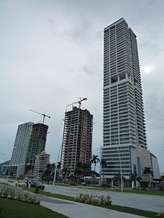
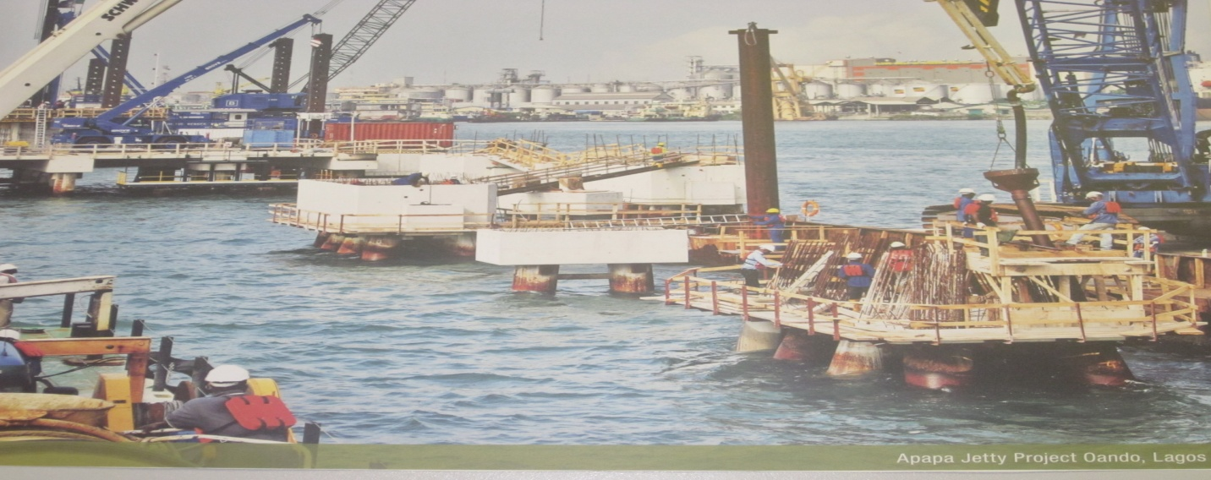
SKYSCRAPERS under Construction
APAPA JETTY PROJECT, OANDO, LAGOS – An Industrial Construction for Oil and Gas Sector

Slide 8
THE CONTRACTOR
This is an independent entity that agrees to furnish certain number or quantity of goods, material, equipment, personnel, and/or services that meet or exceed stated requirements or specifications, at a mutually agreed upon price and within a specified timeframe to another independent entity called contractee, principal, client or project owner.
The entity that offers this wide range of services is also called construction firm.
The Role of a Contractor
A contractor is assigned to a construction project once the design has been completed or is still in progress. This is done by going through a bidding process with different contractors. The contractor is selected by using one of three common selection methods: low-bid selection, best-value selection, or qualifications-based selection.
The contractor or construction firm engages the services of or is represented by a construction manager who should have the ability to handle public safety, time management, cost management, quality management, decision making, design interpretation and implementation, and human resources management.
These activities are to culminate in an effective and efficient delivery of the project and or the actual construction process.

Slide 9
Functions of Construction Site Management The functions of construction management typically include the following:
Specifying project objectives and plans including delineation of scope, budgeting, scheduling, setting performance requirements, and selecting project participants.
Maximizing the resource efficiency through procurement of labour, materials and equipment.
Implementing various operations through proper coordination and control of planning, design, estimating, contracting and construction in the entire process.
Developing effective communications and mechanisms for resolving conflicts

Slide 10
ESSENTIALS FOR A SUCCESSFUL CONSTRUCTION CONTRACT ADMINISTRATION
The question arises – When can we say a Project is successful?
According to Jeffrey Pinto, definitions of successful projects can be surprisingly elusive. How do we know when a project is successful? When it is profitable? If it comes in on budget? On time? When the developed product works or sells? Or when we achieve our long term payback goals?
Generally speaking, any definition of project success must take into consideration the elements that define the very nature of a project – that is, time (schedule adherence), budget, functionality / quality and customer satisfaction. At one time, managers normally applied three criteria of project success:

Slide 11
TIME:
Projects are constrained by a specified time frame during which they must be completed. They are not supposed to continue indefinitely. Thus the first constraint that governs project management involves the basic requirement – the project must come in on or before its established schedule.
COST
A second key constraint for all projects is a limited budget. Projects must meet budgeted allowances in order to use resources as efficiently as possible. Clients do not write blank cheques and hope for the best. Thus the second limit on a project raises the question: Was the project completed within the budget guidelines?

Slide 12
QUALITY PERFORMANCE
All projects are developed in order to meet some initially determined technical specifications. We know before we begin what the project is supposed to do or how the completed project is supposed to operate. Measuring performance then means determining whether the completed project operates according to specifications. The project’s clients naturally expect that the project being developed on their behalf will work as expected. Applying this third criterion is often referred to as conducting a “quality check”.
This so called triple constraint was once the standard by which project performance was routinely assessed. These days, a fourth criterion has been added as:

Slide 13
CLIENT ACCEPTANCE
The principle of client acceptance argues that projects are developed with customers or clients in mind, and their purpose is to satisfy customer’s needs. If client’s acceptance is a key variable, then we must also ask whether the completed project is acceptable to the customer to whom it is intended.
Therefore, project delivery success according to Chan and Kumaraswamy (2001) referred to a project that was delivered at the right time, at the appropriate price and quality standards that provides the clients with a high level of satisfaction. Project delivery is only achieved when there is a measure of satisfaction by the client, the builder and the public (user). The three stakeholders must be satisfied.
We can also think of the criteria for project success in terms of “internal” and “external” conditions.

Slide 14
Internal Conditions:
When project management was practiced primarily by construction and other heavy industries, its chief value was in maintaining internal organizational control over money and time. The traditional triple constraint made perfect sense then.
It focussed internally, on efficiency and productivity measures.
It provided a quantifiable measure of personnel evaluation and
It allowed accountants to control expenses.
More recently however, the traditional triple constraint has come under increasing criticism as a measure of project success.

Slide 15
External Conditions:
Adding the external criterion of client acceptance corrects such obvious shortcomings in the assessment process. First, it refocuses corporate attention outside the organization, toward the customer who would probably be dissatisfied with a failed or flawed project. Likewise it recognises that the final arbiter of project’s success is not the accountants, but rather the marketplace. A project is successful only to the extent of the client who commissioned it. Finally, the criterion of client’s acceptance requires project managers and teams to create an atmosphere of openness and communications throughout the development of the project.
The above brief on these determinants or essentials raises more questions than are answered, for it brings forth many other variants in its wake. I will endeavour to expantiate more on these other variants.

Slide 16
CRITERIA TO MEASURE PROJECT DELIVERY SUCCESS
The success rating of a project may differ according to subjective individual judgment. Comprehensive success criteria must therefore reflect different interests and views, which lead to a multi-dimensional and multi-criteria approach.
Dvri, Raz and Shenhar (2008) identified three aspects of project performance as benchmarks for measuring the success or failure of a project: the implementation process, the perceived value of the project, and client satisfaction with the delivery project.
Shenhar, Dvir and Levy (1997) used thirteen success measures adapted from previous research and showed that these measures could be grouped into four dimensions: (1) Meeting design goals, (2) Benefit to the customer, (3) Commercial success and (4) Future potential.
Sanvido et al., (1992) referred to project delivery success as having results much better than expected or normally observed in terms of cost, schedule, quality, safety, and participant satisfaction.
He went on to define success for a given project delivered as the degree to which project goals and expectations are met. They added that these goals and expectations may include technical, financial, educational, social and professional aspects.
Chua et al., (1999) proposed a hierarchical model for construction project delivery success.
Time, cost, quality target and participation satisfaction have been identified as the main criteria for measuring the overall success of construction project. Of these, cost and time tend to be the most important and visible, always considered as very critical because of their direct economic implications if they are unnecessarily exceeded.

Slide 17
CHALLENGES OF PROJECT DELIVERY
​Chan and Kumaraswamy (1997) evaluated delay factors on the basis of (1) role of the parties in the local construction industry (i.e. clients, consultants and contractors) and (2) the type of project. The results indicate that the five principal and common causes of delays are: poor site management and supervision, unforeseen ground conditions, low speed of decision making involving all the project team, client initiated variations and necessary variations of works.
​Rae and Eden (2002) investigated the impact of the project team, planning and control efforts as they relate to achieving overall project delivery success, better-than-expected schedule performance and better-than-expected budget performance. The results demonstrated that the key success factors affecting the project outcome differently. For example increasing the number of budget updates has more of an impact on achieving better budget performance than it does on achieving better schedule and overall project performance. Implementation of a construction program seems to have a significant impact on achieving overall project success and better schedule performance – especially on fixed contract. Reducing team turnover has more significant impact on improving budget performance than it does in achieving better schedule or overall project performance.
​McKim et al., (2000) performed a survey of 25 reconstruction and 15 new construction projects, followed by structured interview with project participants. A performance comparison was conducted between new and reconstruction projects and factors contributing to schedule and cost overruns were analyzed. New construction projects proved to perform better in relation to reconstruction. The factors influencing these overruns most in reconstruction projects were unforeseen site conditions and changes in the scope of work. Blismas, (2004) grouped the factors under four headings. They are environmental influences, client influences, third-party influences and planning influences.

Slide 18
Project Delivery Criteria
The basic criteria of cost, time and quality have been traditionally used as project success criteria. However, these criteria have been criticized for being inadequate over the years; various attempts have also been made in overcoming the perceived inadequacies. These attempts may be grouped into two different approaches according to Yu, Flett and Bowers (2005), one is to add more dimensions to the basic criteria while the other is to abstract to fewer dimensions.
Chan and Chan (2002) focus on the first approach. They concluded that time, cost and quality forms the basic criteria to project success in almost every article on the subject. They produced a consolidated framework including additional dimensions of user expectation, participants’ satisfaction, environmental performance, health and safety and commercial value. This approach is exemplified by Morris and Hough (1998) and Shenhar et al., (1997). Due to multi-dimensional nature, this approach believes that project success should be viewed from different perspectives of the individual owner, developer, contractor, user and the general public and so on.
In contrast, the second approach reduces the dimensions considered for project success. This approach regards the traditional criteria of cost, time and quality as both excessive and incomplete. The excessiveness is due to the inclusion of time, which is merely a variable in the project cost function. In other words, for a given quality, there exists a relationship between cost and time. As a result, time is not an independent variable and should not be used as such to measure project success. The incompleteness of the traditional criteria becomes obvious if the question is asked “quality of what”. Quality does not stand on its own. It is the project in the totality, not just the quality of the project that should be used for assessing project success.
Yu, Flett and Bowers (2005) suggested that client satisfaction is important while time and cost are less so. Lipovetsky et al., (1997) conclude that some dimensions of success are more important while others are negligible.
But then, while we are in the process of celebrating a project success in terms of time, cost and client’s acceptance, what happens if there was a high degree of injuries to personnel and property that was not well managed during the construction period leading to numerous industrial actions and communal clashes and generating a bad blood among the local communities where the project is sited. Can we say this project is a success?
We will hence consider these and other factors in detail.

Slide 19
CONSTRUCTION PROJECT DURATION (TIME)
A vital section specified in the construction contract is the construction duration, which is established prior to bidding. Construction duration is the time required to complete a specified task or activity which is determined by the owner’s needs to occupy, utilize, or rent the completed space in a project (Bhokha and Ogunlana, 1999).
According to Nkado (1995) construction time can be regarded as the elapsed period from the commencement of site works to the completion and handover of a building to the client. The construction time of a building is usually specified prior to the commencement of construction. It can be deduced from the client‘s brief or derived by the construction planner from available project information. It can also be derived from the critical path in which durations for items of work or activity in sequence cannot be reduced.
Chan and Kumaraswamy (1995) noted that pre contract determination of construction duration is essential for proper cash flow forecasting by both the contractor and the client. It can facilitate optimal resources allocation, financing planning, profitability and efficiency of capital flow within a predetermined time limit. Based on the inputs required for scheduling, all the current methods of scheduling, i.e. Gantt or bar chart, the Critical Path Method (CPM) and Programme Evaluation and Review Technique (PERT), seem to be most applicable only when the detailed design is completed. Without sufficient information, the schedule can be prepared based only on the best guess, i.e. extrapolating using experience of similar projects.
The importance of construction duration has been increasingly recognized within the construction industry, given that it has been traditionally identified as one of the three main critical indices for evaluating the success of a construction project. The construction period demands the focus of attention of all the key participants in the construction process; it is during this period that the greatest part of the resources for a scheme is irreversibly committed. Shorter construction time according to Xiao and Proverbs (2003), leads to improved client satisfaction and places contractors in an advantageous position in the market. Because of time-related overheads and other relevant expenses such as the hire of construction plants and liquidated damage, contactors also prefer to shorten their stay on site to reduce costs and increase their profits.
Construction technology changes with passage of time. Therefore, a model for forecasting the construction duration should be valid in application for a reasonably long period of time without the effects from changes in price level (Bhokha and Ogunlana, 1999).

Slide 20
Factors Affecting Construction Project Duration
Various factors affect construction duration of projects and to varying degree. The larger the project size (i.e. ) the more complex the construction, thus needing longer time to complete. Nkado (1995) indicated that the time outcome of a project would be affected by the form of the construction, the size of the project, the number of storeys, the contractual system, the tendering procedure, the existence of a basement in case of buildings, the management efficiency of the construction firm and the development of coordination between the various agencies involved in the construction.
Chan and Kumaraswamy (1995) confirmed that the height of a building, represented by the number of floors, indicates the construction techniques, major equipment needed and construction sequence, all of which affect construction duration. The location of a building has a significant effect on construction duration, i.e. whether or not restrictions exist, availability of services, supply of resources, use of major equipment and productivity on site.
The factors which have also been described by Xiao and Proverbs (2003), as affecting construction duration include buildability, management and leadership, knowledge of subcontractors works, the nature of relationships between the general contractor, subcontractor and client’s agent and the degree of coordination in design information and the completeness of project information. Bhokha and Ogunlana (1999) listed other factors that ultimately affect site productivity such as work space availability, attendance of operatives, learning curve, weather, labour relations, project complexity, foundation condition and effectiveness of supervision.

Slide 21
TASK :– CREATING A TIMELINE
From a contractor’s viewpoint, a practical way of resolving time issues is to perform at first a “Construction Scheduling”.
Construction Scheduling Process details the sequence of activities involved in planning adequately for the project at hand with the aim of tracking progress and ensuring delivery of client’s expectations.
The task involved is to :-
Identify the site.
Understand the prevailing challenges and how to mitigate the challenges.
General assessment of the environment.
Resourcing i.e. material, labour etc.
Note all the other challenges that might affect the operations at the site.
Begin to sequence the activities based on the Bill of Quantities, the Heavy Engineering Project Scheduling and the Drawings using the insight
received from site.
Then draw up a Method Statement for each activity to be performed.
A method statement is a document detailing how particular work activities will be carried out including the possible dangers/risks associated with it and methods of control.
The general aim of the task is that –
Timelines are to be developed considering the number of resources – labour, material and equipment required to achieve the work program. This should be done using a Standard Output Rate. The Standard Output Rate are measurements used to determine pricing and duration for project i.e. number of labour required to complete certain tasks or area, quantity of materials required per square metre etc.
A detailed review of the initial contract document and work program submitted with the tender should be done. This is expected to give the Project Manager, Site Engineer and Planner a clear understanding of the basis of the estimate as it relates to the following – nature and scope of the project; construction methods and equipment; project timetable; ambiguities in the contract documents; engineering requirements; potential hazards to the success of the project; errors and omissions in the estimate and necessary priorities in the development of the detailed work program.
The subcontractors timelines will be captured and apply inside the main program as applicable.
As the project evolves, there might be a review to include areas that have not been captured in initial drawings. If this causes a review to the plan, it will be submitted to the client and consultant for approval.
Eventually, if the client is uncomfortable with the timeline of the project, negotiations occur and repeat/updated work plans are processed.
Timeline changes only occur when the scope of the project has changed. This is taken into consideration to develop a work program for that aspect newly introduced. This work program is now priced using the already established rate

Slide 22
CONSTRUCTION PROJECT COST
The cost of construction is an important concern in any project. Construction cost is one of the major criteria of decision making at the early stages of a project design process. The cost of a building is impacted significantly by decisions made at the design phase (Love, Tse and Edwards, 2005). Wilmot and Mei (2005) found that in addition to the input costs of construction such as labour, equipment and materials and their escalation in price due to inflation, the total volume of contracts bid in a particular year affects bid prices due to the changes in competition.
Estimated Cost
These are the costs calculated by the estimator for the preparation of the contract’s tender. Each company uses its own tables of standard work outputs for the different operations of work, and these are used by the contractor when preparing pricing for new projects. A prudent contractor will review and revise these regularly, but owing to the variability of construction work generally, the outputs that might be derived from site feedback are only rarely revised. This then often has more to do with new methods of construction or to changes in techniques or terminology. The process of estimating therefore becomes more subjective, based upon experience, rather than necessarily on the use of performance data. Skitmore (2002) in his research indicated that the more experience estimators have, the more accurate they are likely to be in their estimating of costs.

Slide 23
Target Cost
The outputs that the estimator has used are then adopted as a basis for the construction operations on site. The budget or target costs attempt to relate costs to specific tasks that are undertaken on site. Whilst the estimator may choose an average output for the whole of an item in a bill of quantities, the cost surveyor will need to analyze these outputs separately depending upon the complexities on site. The location of the work on site is known to have an influence upon the outputs of the operatives’ work. Target costs are also often lower than estimated costs, since they are used as a basis for the contractor’s incentives scheme. They are also generally lower to allow for the possibility of unforeseen circumstances.
Actual Cost
These represent the actual recorded data retrieved from site in the ‘as – done‘ or “as – built” mode and built up with approved rates to arrive at the actual cost of construction. Actual labour outputs and judicious materials utilization may show a considerable difference when compared to budget outputs due largely to the fact that incentive schemes are in operation.

Slide 24
Factors Affecting Construction Cost
Cost is affected by a large number of factors. This can be explained by the fact that construction is a multi-disciplinary industry and its work involves many parties such as client, professionals, contractors and supplier. Therefore integrated efforts of various parties and their decisions regarding the design, technology and implementation of the project can have significant effect on the overall project cost.
Several studies have set out to identify the factors that affect construction costs. In a study conducted by Love, Tse and Edwards, (2005), it was found that location, contract duration; size of the project and type of project, all had a measurable effect on construction costs. Sanvido et al., (1992) found the absence of late changes in design, close attention to deadlines and completeness and timeliness of project information were factors that influence the cost of building projects. Chitkara (2011) identified four main parameters that can sufficiently define a construction project cost as; size of the project, its complexity, quality of work to be achieved and the completion time.

Slide 25
CRITICAL ISSUES IN COST DELIVERY OF A PROJECT
Client’s Financial Planning and Budget
A major issue in sound project delivery is funding, and this occurs either at the inception of a project or during the project’s lifetime. The contractor is not obliged to continue the execution of the contract in a situation where the project is starved of funds. The Client being the prime mover and initiator of a project owes the other stakeholders in the industry a huge obligation to adequately plan for the project financing and to ensure the funds are disbursed as and when due especially upon certification by the appropriate personnel.
Valuation, certification and voucher processing are just as important as any other aspect of contract administration. Payment to the contractor for the supplies and services delivered is the client's obligation under the contract. The client expects the contractor to meet all contract requirements for quality, quantity and timeliness. The contractor expects no less of the client in meeting its obligation to timely, accurate payment for supplies and services received. A plan or process for quickly and efficiently meeting this obligation is as essential as any to ensuring a success of the contract.
But then, since my purview is contractor’s viewpoint I would not be spending much time on this but rather concentrate on the contractor’s cost control procedures. Thus, the following items are pertinent to a contractor’s optimum performance.

Slide 26
Contractor progress payment schedule
A Contractor progress payment schedule is a schedule of when (according to project milestones or specified dates) contractors and suppliers will be paid for the current progress of installed and executed work.
Progress payments are partial payments for work completed within a time frame usually a month, during a construction period. Progress payments are made to main contractors, subcontractors, and suppliers as construction projects progress. Payments are typically made on a monthly basis but could be modified to meet certain milestones. Progress payments are an important part of contract administration for the contractor. Proper preparation of the information necessary for payment processing can help the contractor financially to accelerate and/or complete the project.
Variations
A variation is a change to the scope of work outlined in the contract, such as an addition to or reduction in the scope and quantity of work that may result in an increase or decrease in the contract value.
Failure to fully and accurately document variations to the original contract in writing is a frequent cause of disputes.
Extension of Time
The Extension of Time form should be used to confirm any extensions of time that will affect the project completion date, due to a delay as allowed for in the contract.

Slide 27
Inflation and Cost Adjustment Guidelines
There is a risk that, during the course of a commercial contract, the costs of performing that contract will rise or fall from the costs initially estimated. This risk cannot be controlled by the principal or the contractor.
The cost of materials, equipment, services and labour has been on the increase since the 1980s and it is no longer practical to simply add a nominal allowance for this inflation to the bottom of a cost estimate. Neither is it something that can be ignored in the evaluation of projects. Thus inflation can often have a catastrophic effect on the viability of capital expenditure projects.
The consequences of this inflation can be different for a client and a contractor, although it can adversely affect the cash flow of both. However, no contractor will accept a contract without escalation clauses linked to the appropriate indices, save for a lump sum contract where all risks are already built into the contract. A price adjustment formular is often employed so that a contractor can be protected against the worst effects of inflation. Unfortunately this is not a complete protection as index – linked payments involved in a contract, such as profit margin, administrative costs and retentions in individual projects may be different from that shown in official indices.
Most importantly, payments for the effects of inflation generally lag behind payments for work done, because of the form of the contract and delays in the publication of inflation indices and this increases the gap between funds in and out and increases the amount of funds required.
Also as inflation goes up, interest rates also normally go up and this increases the cost of financing this working capital.
Retentions are also a problem; as by the time they are paid, often long after the contract is nominally completed, inflation may have considerably reduced their value.
Contractors may have difficulty in estimating the long-term effects of changes in costs and may:
Vary price tenders conservatively, leading to unnecessarily high contract prices; or
Guess the effects of changes in costs, leading to tender prices that are either excessive, or uneconomically low (with consequent risk of financial failure of the contractor).
Cost adjustment provisions in contracts address this risk by providing mechanisms for adjusting contract payment to reflect changes in costs, but they only apply to long-term costs and some specific costs. So, contractors retain the risk of short-term fluctuations in costs, and the risk of the calculated cost adjustment not reflecting actual changes in costs.

Slide 28
Which items will cost adjustment apply to?
Cost adjustment may be applied to the following:
Labour and materials.
Currency exchange rates for goods purchased in foreign currency.
Other costs, including duties and taxes or shipping and transport.
In normal contracting strategies, cost adjustment provisions should only be applicable to costs, typically long-term costs that might cause tenderers to overestimate or uneconomically underestimate contract prices.
Cost Adjustment Guidelines
An allowance normally termed contingency or management reserve must be added to each estimate to cover the following factors:-
Errors in estimating.
Minor omissions from the estimates.
Minor changes in the design as it progresses.
Minor changes to compensate for field conditions when it comes to construction.
A management reserve to be used at the discretion of the consultant and the client’s representative for changes required to expedite the work, unforeseen minor contingencies or other minor areas of uncertainty.
Normal variations which are used in estimating data.

Slide 29
RISK & FINANCIAL MANAGEMENT
Managing risk is one of the fundamental principles of running a successful business – and failure to properly identify and manage risks is the reason why many good businesses fail.
As the construction industry moves through cycles of boom and bust, many contractors are caught out by sudden increases in costs and massive skill shortages. These conditions can severely delay the completion of jobs, further compounding losses suffered by a contractor who has taken on the risk.
Contractual risk
One of the major contributing causes of these massive losses has been the allocation of the majority of risk to the contractor, via the contract document, despite the contractor having very little control over its management. Contractors take on this risk for various reasons – the main one being the hope that issues won’t eventuate.
As a contractor, if you are going to take on the risk, you need to adequately evaluate the associated costs and properly organise your affairs, or face substantial and unrecoverable expenses. You should be particularly careful not to take on an area of risk that you have no control over.
Some areas to look out for include:
No provision for extensions of time to contractors for inclement weather.
No provision for extensions of time for industrial disruption.
Contractors held responsible for deficiencies associated with the design and documentation provided by the client.
No variations allowed under the contract.
Contractors responsible for adjoining neighbours and boundary issues.
Contractors taking on insurance conditions that cannot be obtained.
Good contract administration can help to reduce this contractual risk.

Slide 30
Financial & credit risk management
Financial and credit risk management are also imperative processes. Before the contract is signed, you should ensure that you are satisfied that the client has the financial capacity to pay the contract price – don’t be afraid to ask for evidence to support this. If in doubt, you should demand a bond insurance for security of payment. Sometimes you hear of a major contractor backing out of a contract midway in negotiations. This is one of the major reasons. A contractor worth its salt would never shy away from this practice because it is concomitant to the overall success of a project.
Preparation of budgets and financial recording processes and procedures are integral for monitoring the financial performance of a project and all the elements involved.
The payments process must specifically include:
Payment claims (Subcontracts)
Variations
Contract claims
Interest payments
Retentions
Bank guarantees
Bank charges/set offs

Slide 31
Time and Cost Overruns of Construction Projects
Criticism of the construction industry has arisen because of projects that have taken a longer time to complete than stipulated. The possible reasons for these are: budget overruns; a large number of claims and litigation; technical; social; physical; economic and political factors. A common reason is incompetent supervision of unskilled workmen. The best contractor is not always chosen for the project. Many construction projects suffer from time overrun. Time overrun give rise to disruption of work, loss of productivity, late completion of project, increased time related costs, third party claims and abandonment or termination of contract. Ayeitan (2010)supports these assertions by declaring that the consequences of delays in project delivery are grave, ranging from litigation to claims and disputes, to outright abandonment of the project. It is important that general management keep track of project progress to reduce the possibility of delay occurrence or identify it at early stages.
Delay is a situation when the contractor and the project owner jointly or severally contribute to the non-completion of the project within the original or stipulated or agreed contract period. When projects are delayed, they are either accelerated or have their duration extended beyond the scheduled completion date. These are not without some cost consequences. The study of time and cost overrun in construction projects realization has great significance. Overruns analyses raised the quality level of preparation and control of projects. Time overrun occurs in almost every construction project and the significance of these varies considerably from project to project. (Tumi, Omran and Pakir, 2009) have defined that delay is the time during which some part of construction project has been extended or not performed due to an unanticipated circumstances.
An incident of delay can originate from within the contractor’s organization or from any of the other factors interfacing upon construction project. Some projects are only a few days behind the schedule; some are delayed over a year. So it is essential to define the actual causes of delays in construction projects. Ogunlana et al, (1996) studied the delays in building projects in Thailand, as an example of developing economies. They concluded that the problems of the construction industry in developing economies could be nested in three layers: (1) problem of shortages or inadequacies in industry infrastructure, mainly supply resources; (2) problems caused by clients and consultants and (3) problems caused by incompetence of contractors.

Slide 32
QUALITY / PERFORMANCE
QUALITY CONTROL
Quality control is a process that describes the sequence of activities involved in ensuring work is done according to specifications, contract requirements and standards required by the client in the drawings and bill of quantities. Also it is a process of compliance with laws and regulations and the minimum standards specified for this type of work by Government regulation agencies. Quality management is the totality of all the processes involved. It involves quality planning, quality assurance, quality control and quality improvement.
The contractor’s quantity surveyor is very much involved in this process from the onset and matters are more often referred to him for inputs at every other stage.
The first step for the contractor is for specifications to be extracted from the Bill of Quantities and broken down in form of material schedule. The Quantity Surveyor then accesses or visits the source of these materials sometimes physically but often by e – communications to check for quality, obtain samples, quality certificates and pricing. Next, a method statement is developed detailing how all the materials will be combined to achieve the required specification.
These become necessary because some clients demand for samples of materials, the quality certificates and the method statement to achieving the specification before granting approval for a section or item of work to proceed for execution.
Tests certificates are equally desirable and are often specified by the client’s consultants to provide proof that materials have been tested or inspected for the specified quality.
Quality performance means “getting it right the first time”. Quality is free but “Unquality” of things costs money. The total process is indeed an essential to a successful contract administration.

Slide 33
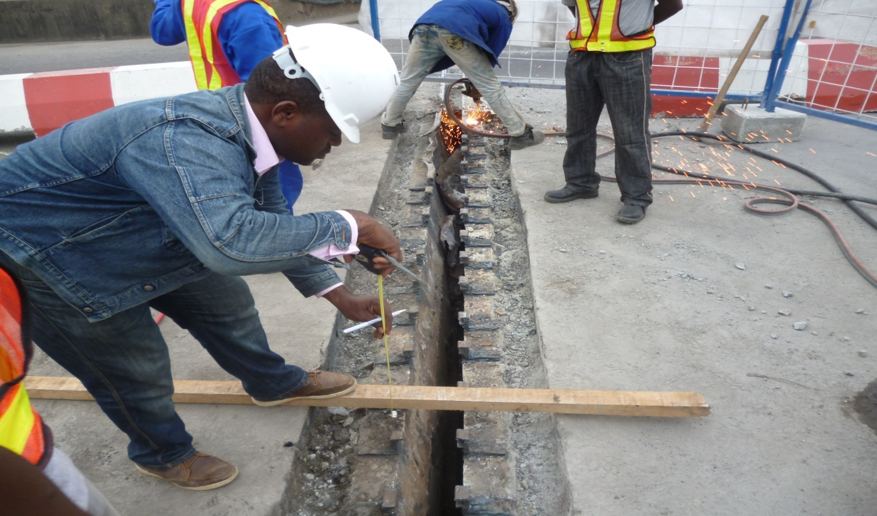
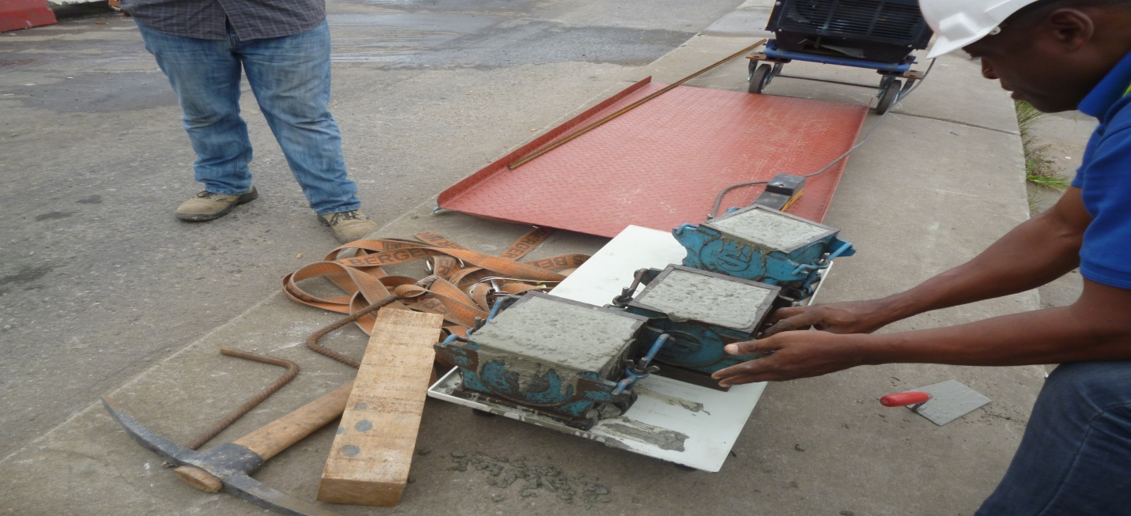
REPAIRS OF EXPANSION JOINT, EKO BRIDGE
QUALITY CONTROL

Slide 34
PERFORMANCE AND CONSTRUCTION ACTIVITY DOCUMENTATION
As aid to performance, project meetings take place at scheduled intervals to discuss the progress on the construction site and any concerns or issues. The discussion and any decisions made at the meeting must be documented.
Diaries, logs, and daily field reports keep track of the daily activities on a job site each day.
Diaries: Each member of the project team is expected to keep a project diary. The diary contains summaries of the day's events in the member's own words. They are used to keep track of any daily work activity, conversations, observations, or any other relevant information regarding the construction activities. Diaries can be referred to when disputes arise and a diary happens to contain information connected with the disagreement. Diaries that are handwritten can be used as evidence in court.
Logs: Logs keep track of the regular activities on the job site such as phone logs, transmittal logs, delivery logs, and RFI (Request for Information) logs.
Daily field reports: Daily field reports are a more formal way of recording information on the job site. They contain information that includes the day's activities, temperature and weather conditions, delivered equipment or materials, visitors on the site, and equipment used that day.
The followings are a range of resources that has been developed to help in administering contracts.
Inclement weather calendar
Construction period calendar
Project documentation checklist
Supervisors' construction checklist.

Slide 35
Calculating inclement weather days
In the written contract, you are required to specify allowances for likely delays to the construction period, including the number of days delay as a result of inclement weather. Inclement weather calendar helps in estimating the number of inclement weather days; The Nigerian Meteorological Office provides data and information on weather forecast for use in construction zones. My office had availed ourselves of these services in times past.
Construction period calendar
The construction period calendar will help you to calculate the anticipated project completion
Project documentation checklist
The project documentation checklist is a comprehensive checklist to help members ensure each step of the construction process has been completed.

Slide 36
CLIENTS ACCEPTANCE
Contract administration involves managing your contracts to make sure you comply with and fulfil the contract conditions. It starts with developing clear, concise performance based statements of work to the extent possible, and preparing a contract administration plan that cost effectively measures the contractor's performance and provides documentation to pay accordingly.
Good contract administration ensures clients or customer satisfaction and minimises disputes.
Contract Administration involves those activities performed by the trio of the client or his representatives, the consultant and the contractor after a contract has been awarded to determine how well the consultant and the contractor performed to meet the requirements of the contract. It encompasses all dealings between the client and the contractor from the time the contract is awarded until the work has been completed and accepted or the contract terminated, payment has been made, and disputes have been resolved. As such, contract administration constitutes that primary part of the procurement process that assures the client gets what he paid for.
Where appropriate, an alternative dispute resolution (ADR) technique known as "partnering" should be discussed with the contractor to help avoid future contract administration problems. Partnering is a technique to prevent disputes from occurring. It involves client and contractor management staff mutually developing a "plan for success.
Good contract administration assures that the end users are satisfied with the product or service being obtained under the contract. One way to accomplish customer satisfaction is to obtain input directly from the customers through the use of customer satisfaction surveys. These surveys help to improve contractor performance because the feedback can be used to notify the contractor when specified aspects of the contract are not being met. In addition, the contracting and program officials can use the information as a source of past performance information on subsequent contract awards. Customer satisfaction surveys also help to improve communications between the procurement, program, and contractor personnel.
The primary objective of the contract administration project is to establish best practices that agencies can use to improve contract administration to assure responsiveness to customers and best value to taxpayers. Improving contract administration practices will help to achieve excellence in contractor performance so that the client receives goods and services on time, and within budget.

Slide 37
Due Process is defined as technique that client representatives and agencies may use to help detect and avoid problems in the acquisition, management, and administration of contracts.
Best Practices are practical techniques gained from practical experience that may be used to improve the procurement process.
Communication
Communication is the key to avoiding, minimising and managing disputes. Many disputes arise because of poor communication.
Misunderstandings and unrealistic expectations are a regular occurrence on a construction site – and instead of being resolved via open and honest communication, a lack of communication can cause both parties to become emotional, which means you can (perhaps unnecessarily) end up in a dispute situation.
As a contractor or sub contractor, it is important to develop an open line of communication with your client from day one and encourage them to discuss any issues or problems as early as possible. Discussing issues upfront and listening carefully to your client’s concerns can ensure they don’t escalate into a dispute.
If you think an issue has been misunderstood, make sure you clarify with your client – taking the time to ensure both parties are clear on issues early on as this can help avoid a much more complicated situation later.

Slide 38
TEN COMMANDMENTS FOR MANAGING DISPUTES
These simple yet often ignored steps can help you better manage and minimise disputes in your contract or on site.
Maintain a good working relationship.
Do not allow complaints to escalate to a dispute by avoiding or ignoring your client.
Make time to communicate with your client face-to-face and give your client the opportunity to explain the nature of their complaint.
Do not interrupt while your client is speaking – no matter how ‘far-fetched’ you think their side of the events is.
Listen, listen and listen.
As your client talks, listen and take notes.
After your client has finished speaking respond in a calm, clear and non-threatening manner.
Once you have both agreed on an appropriate course of action, act quickly to implement the resolution.
If you cannot resolve the complaint, seek help sooner rather than later.
In any related dispute you should apply sound commercial judgment by pursuing a course of action that minimises your loss (monetary/relationships).
Strategies for dispute management will differ depending on the individual circumstances, so make sure you consider all the aspects before proceeding with a course of action.

Slide 39
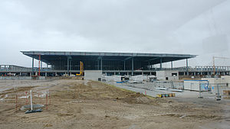
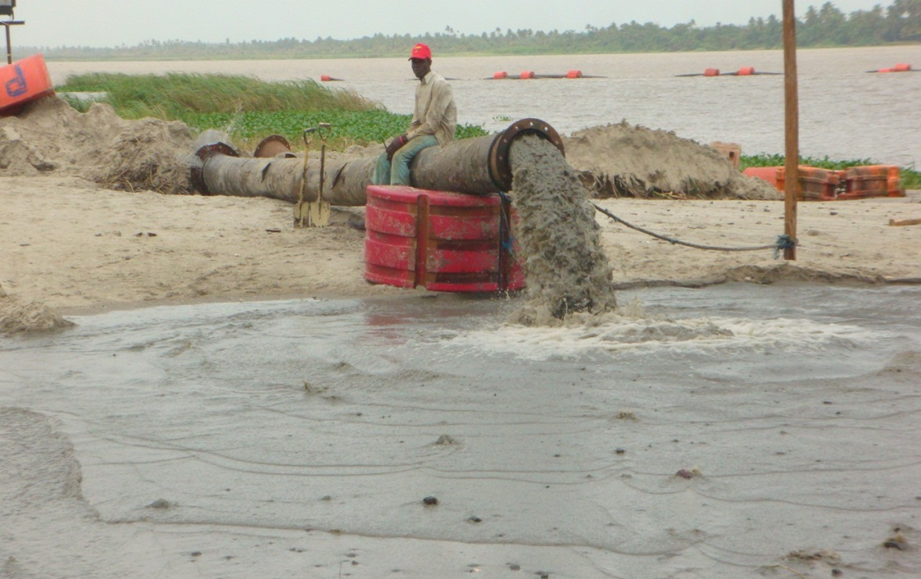
BERLIN BRANDENBURG AIRPORT; an Example of Poor Administration of Construction Project.
DREDGING IN PROGRESS

Slide 40
RESOLVING DISPUTES
Mediation: Mediation uses a third party mediator to resolve any disputes. The mediator helps both disputing parties to come to a mutual agreement. This process ensures that no attorneys become involved in the dispute and is less time-consuming.
Mini trial: A mini trial takes more time and money than a mediation. The mini trial takes place in an informal setting and involves some type of advisor or attorney that must be paid. The disputing parties may come to an agreement or the third party advisor may offer their advice. The agreement is nonbinding and can be broken.
Arbitration: Arbitration is the most costly and time-consuming way to resolve a dispute. Each party is represented by an attorney while witnesses and evidence are presented. Once all information is provided on the issue, the arbitrator makes a ruling which provides the final decision. The arbitrator provides the final decision on what must be done and it is a binding agreement between each of the disputing parties.

Slide 41
HEALTH, SAFETY AND ENVIRONMENT (HSE)
Health and Safety
Construction and industrial activities generally involve people, machines, materials, chemicals and the environment. In the course of operations in which these elements interact, it does happen that one or the other of the elements is impacted upon adversely and there is injury or damage, and it is said an accident has occurred. Research has established that accidents are caused by unsafe acts and unsafe conditions. The negative actions or situations are usually unplanned, unexpected and the resultant unwanted.
The consequences impact adversely on the industry, its people, plant, machinery, equipment, materials and the environment within which the site is located.
The injured employee or persons experience physical pain, mental agony, disability which could be temporary or permanent, loss of leisure, earning and possibly life or debilitating health challenges.
The company suffers economic loss, production loss, non – productive time, loss of reputation and faces possible litigation. Loss of income comes in for accident investigation, non – productive time, replacement costs, compensation payments, insurance payments, legal costs and fees.
The community suffers financial and other contributions within the period and may get entangled in litigation for compensation.
The Government suffers loss of taxes paid by the company and the employee.
Therefore, strict adherence to safety issues and requirements pays great dividends to all stakeholders.
The construction firm has the continued service of a healthy, competent and efficient workforce, which ensures achievement of targeted quality and quantity of production, conservation of funds that would otherwise have been spent on medical, compensation and lost time bills. Safety practice therefore ensures greater profits.
The employee remains healthy and fit and is in a position to achieve his life ambition. He remains in employment and is employable in an appropriate job with full earning capacity.
The community continues to reap the benefits of the contributions of the company.
Lastly, Government earns increased revenue from the increased profits earned by the company, and from the employee who pays tax from his earnings.

Slide 42
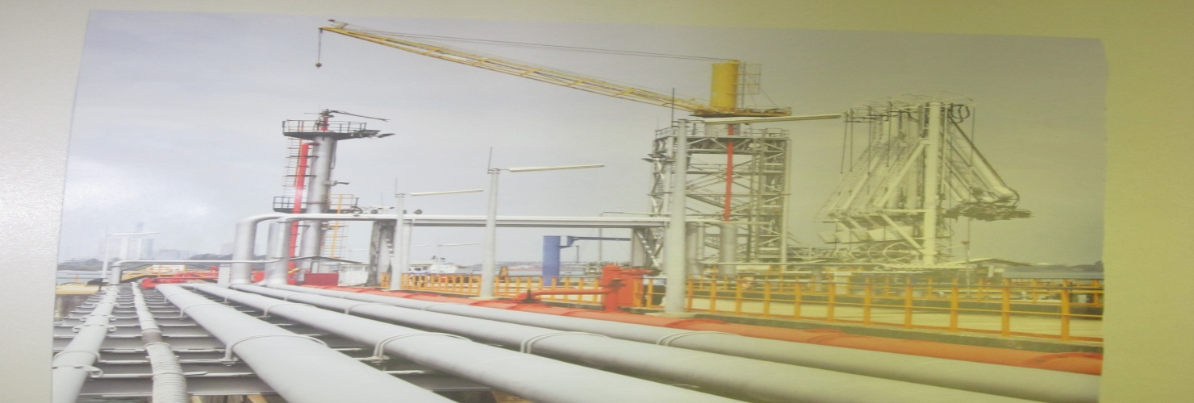
PERFORMANCE AWARDS FOR SAFETY
PIPELINE CONSTRUCTION, NIGER DELTA

Slide 43
Environmental Impact
Environmental impact also plays a major role in assessing the success of a project. The consequences of neglect of this all important factor have been a major source of contention and communal strife in local communities especially in the Oil Producing areas. This has gone to the extent of attracting global attention and mention must be made of the landmark judgment of the International Court of Arbitration that awarded compensation costs to the people of the Niger Delta for the suffer of pollution and environmental degradation

Slide 44
THE CONTRACTOR’S PERSPECTIVE
Pre-construction
The pre-construction stage begins when the client gives a notice to proceed to the contractor that they have been chosen through the bidding process. A notice to proceed is when the client gives permission to the contractor to begin their work on the project. The first step is to assign the project team which includes the project manager, contract administrator, site engineer and other key officials.
During the pre-construction stage, a site investigation must take place. A site investigation takes place to discover if any steps need to be implemented on the job site. This is in order to get the site ready before the actual construction begins. This also includes any unforeseen conditions such as historical artifacts or environment problems. A soil test must be done to determine if the soil is in good condition to be built upon.

Slide 45
Contract Documentation
The contract documentation is all documents which, when combined, form the basis of the contract, including all pre-tender, tender and contractual documentation. The contractor’s quote can also form part of the contract documentation.
The contract documentation gives the contractor sufficient information to be able to complete the building or civil works and meet the service delivery requirements.
The documents that make up the contract documentation include:
Contract – the binding document or agreement between the client and the contractor to carry out the building or civil work. The type of contract used depends on the size and complexity of the project.
Contract conditions – define the legal rights and obligations, or the rules by which each party must comply.
Special contract conditions – as the name suggests are special conditions that are an extension of the general conditions and apply specifically to the project.
Bill of quantities – a list of materials, parts and labour (and their costs) that are included in the contract. The bill of quantities is helpful in valuing variations and assists in the preparation of progress claims.
Drawings – the architectural and structural plans of the building
Specifications – set out the technical requirements of the work. They describe the project and requirements for materials and workmanship, and add clarity to the drawings.
Other documents – including technical and pricing schedules.

Slide 46
Procurement
The procurement stage is when labour, materials and equipment needed to complete the project are purchased. This can be done by the main contractor if the company does all their own construction work. If the contractor does not do their own work, they obtain it through subcontractors. Domestic Subcontractors are contractors who specialize in one particular aspect of the construction work such as concrete, welding, glass, or carpentry and are engaged domestically by the main contractor. Nominated Subcontractors are hired the same way a main contractor would be, which is through the bidding process. Purchase orders are also part of the procurement stage.

Slide 47
Construction
The construction stage begins with a pre-construction meeting brought together by the Site engineer. The pre-construction meeting is meant to make decisions dealing with work hours, material storage, quality control, and site access. The next step is to move everything onto the construction site and set it all up.
At this stage, construction monitoring and supervision is of great importance to ensure that a project is completed on time and on budget, while meeting all relevant regulations and quality standards.

Slide 48
Completion
A successful completion of contract is an important aspect of contract administration. Contract completion begins when the contract has been physically completed, i.e., all services have been performed and products delivered. Certificate of practical completion is issued and the defects liability period commences.
This phase is concluded when all administrative actions have been completed, all disputes settled, and the defects liability period of six months lapses. Hopefully, final accounts are prepared and final payments are made (on time).
The process can be simple or complex depending on the contract type

Slide 49
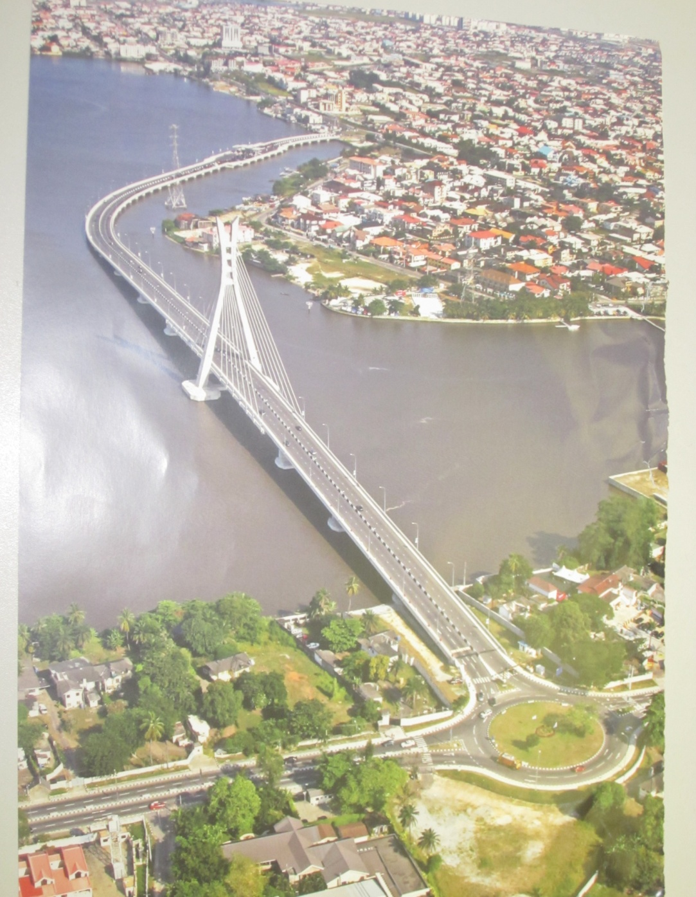
LEKKI – IKOYI BRIDGE
NIGHT VIEW OF LEKKI – IKOYI BRIDGE

Slide 50
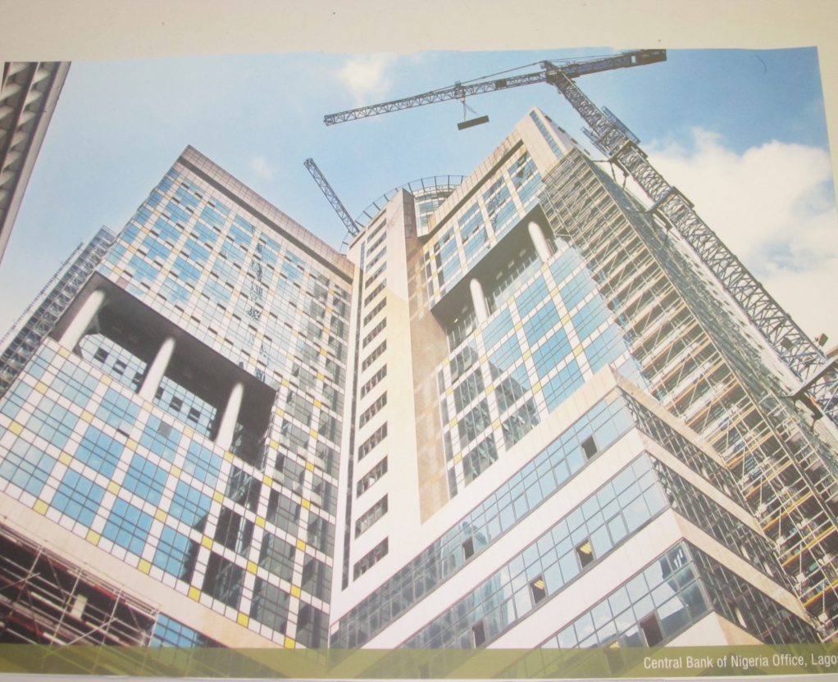
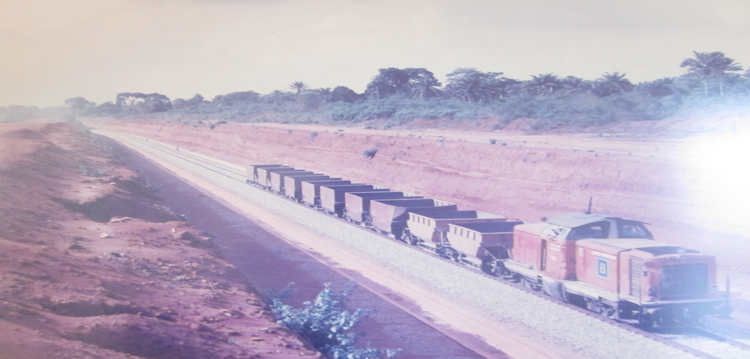
COMMERCIAL CONSTRUCTION, CENTRAL BANK LAGOS
RAILWAY AJAOKUTA – WARRI

Slide 51
CHALLENGES AND CONCLUSION
THE ESSENTIALS AS A REALISTIC TOOL OF PROJECT ASSESSMENT
Traditional criteria to assessing the success of a construction project administration has been identified as meeting the targets of cost and time. Quality and performance standards have been added over time to make for a more robust assessment.
Further research has proved that these three could not satisfy the demands of the times and a fourth in the form of client’s acceptance has therefore been introduced. But client’s acceptance is subjective, for we have three types of clients – (i). Those that are informed i.e. those that know of specifications and other forms of construction personally or through its representatives. (ii). Those that are semi informed and (3). Those that are not informed, that depends totally on the contractor’s performance and judgment. Hence, client’s acceptance has its limitations also.
An additional approach to project assessment argues that another factor, the fifth, must always be taken into consideration: the promise that the delivered project can generate future opportunities, whether commercial or technical for the contractor’s organization, the construction industry, the client and the end users of the project.

Slide 52
ROLE OF THE QUANTITY SURVEYOR
Successful administration of construction contracts initially depends largely on a clear set of expectations by the client, the consultants and the contractor as the primary movers of a contract.
Post award orientation, either by conference, letter or some other form of communication, should be the beginning of the actual process of good contract administration. This communication process can be a useful tool that helps the client and contractor achieve a clear and mutual understanding of the contract requirements, helps the contractor understand the roles and responsibilities of the officials who will administer the contract, and reduces future problems. It is helpful to have a pre-meeting with applicable program and contracting officials prior to the post award orientation conference so that there is a clear understanding of their specific responsibilities and restrictions in administering the contract. Items that should be discussed at the pre-meeting include such things as the authority of the personnel who will administer the contract, quality control and testing, the specific contract deliverable requirements, special contract provisions, the client’s procedures for monitoring and measuring performance, contractor billing, voucher approval, and payment procedures.
The nominal role of the contractor’s quantity surveyor includes but is not limited to measurements, valuations, preparation of variations and fluctuations, all aspects of cost estimation, cost modeling, cost control, cost analysis, interim and final certificates. These are essentials that fall within his purview.
However, in a typical major project, while the contractor’s top engineer is referred to as project or operations manager, the contractor’s top quantity surveyor is many times referred to as contract manager.
Thus, the contractor’s top quantity surveyor in the capacity of the contract manager plays an active and key role in construction cost management and a successful administration of projects – as he is often relied upon and called forth to provide impartial advice on matters such as:
Interpretation of contract clauses.
Information on specifications.
Adjudication in disputes.
Optimum use of available funds.
Control of the scope of the work.
Project scheduling and rescheduling at project intervals.
Optimum use of design and construction firms' skills and talents.
Avoidance of delays; changes and disputes.
Enhancing project design and construction quality.
Optimum flexibility in contracting and procurement.
Cash-flow management.
Client’s relations.
A good contract administration programme is essential to improving contractor performance under any contract. And the quantity surveyor has a key role to play. The best practices and due process that have been outlined in this lecture is a first step at providing some practical guidance that should help to improve the contract administration process.

Slide 53
INTRODUCTION OF HEALTH, SAFETY AND ENVIRONMENT (HSE) PRACTICE AS A TOOL OF PROJECT SUCCESS ASSESSMENT
On Page 10 of this write up we made this assertion – “But then, while we are in the process of celebrating a project success in terms of time, cost and client’s acceptance, what happens if there was a high degree of injuries to personnel and property that was not well managed during the construction period leading to numerous industrial actions and communal clashes and generating a bad blood among the local communities where the project is sited. Can we say this project is a success?”
The overall importance of the Health, Safety and Environmental (HSE) practice in execution and administration of construction projects cannot be overemphasized. It answers the (i). Moral; (ii). Economic; (iii). Legal and (iv). Reputation factors of the project administration. It gives a human face to the intent of the initiator of the project, the constructor and the community. It eliminates waste and ensures a higher profitability for the construction team.
The oil and gas sector of the economy has activated and benefited immensely from this practice.
I strongly believe the construction industry should endeavour to emphasize more on the practice and use it hence as an essential tool to assessing a successful administration and delivery of construction projects.

Slide 54
THE ROLE OF THE GOVERNMENT
We believe that all parties need to realize the importance of good contract administration.
The Government through its various agencies has a key role to play in achieving this, for the following reasons. Firstly, they are the largest client in a developing economy as ours. Secondly even in private projects, the Government and its agencies are relied upon to approve survey plans, architectural plans and engineering designs, monitor the project to ensure it conforms to laid down rules and regulations, quality control and performance standards. In case of disputes, it is called upon to adjudicate.
Convening a forum to discuss these best practices may help Government agencies focus more attention to them and begin using them to help resolve problems that may arise. Structuring a contracting administration programme by the type of activity, e.g., contract monitoring, payment process review, contractor performance evaluation, using various levels (Level 1 - proactive, Level 2 - active, and Level 3 - reactive) may also help to better allocate contract administration resources so that these best practices can be useful.
Thanking you for the audience and your invaluable time to be a part of this lecture

Slide 55
GOD BLESS YOU ALL!!!!!!!!!
FRED BOLAJI JOHNSON
DECEMBER 2014

Slide 56
REFERENCES
Parag Diwan – Project Management, Kuala Lumpur, Malaysia 2006
Joseph T. Bockrath and Fredrick L. Plotnick – Contracts and the Legal Environment for Engineers and Architects 2011.
Jeffrey Pinto – Project Mangement, Upper Saddle River, New Jersey 2007
3rd Forum “International Construction Project Management, Berlin 2003
Barbara I. Jackson – Construction Management Jumpstart (2nd Ed) Indianapolis, Indiana 2010
Chris Hendrickson – What is Construction Project Management?, 2008
Minks William – Construction Jobsite Management 2011
The problems with the Berlin Brandenburg Airport – New York Times
Date Nitin – Capital Project Management Overview
Date Nitin – Implementing CPMS as part of overall IT strategy.
Halpin Daniel – Construction Management, Hoboken, NJ 2006
Stagner Steve – Design Build and Alternative Project Delivery in Texas, Texas Council of Engineering Companies 2011
A guide to Best Practices for Contract Administration – Office of the Federal Procurement Policy, Washington DC 1994

